Slide 1
The 13.35 to Grand Central Mitigation
Journey to the Centre of the Circs
Student
Affairs
|

Slide 2
Stops – What’s Covered
Context: Background, Structure, Process and Numbers
Centralised Consideration: The Advantages
Centralised Consideration: The Disadvantages
Conclusions
Contact Details
Student
Affairs
|

Slide 3
Stop 1 – Context – Background
Queries & Resolutions: ASK Enquiry Service; International Student Visa Advisers; Student Affairs Advisers; Student Casework
Student casework incorporates: Appeals; Complaints; Academic and General Misconduct; Suspensions; Fitness to Practise and DBS; Fitness to Study; Extenuating Circumstances; OIA
Predominantly work on casework
Student
Affairs
|

Slide 4
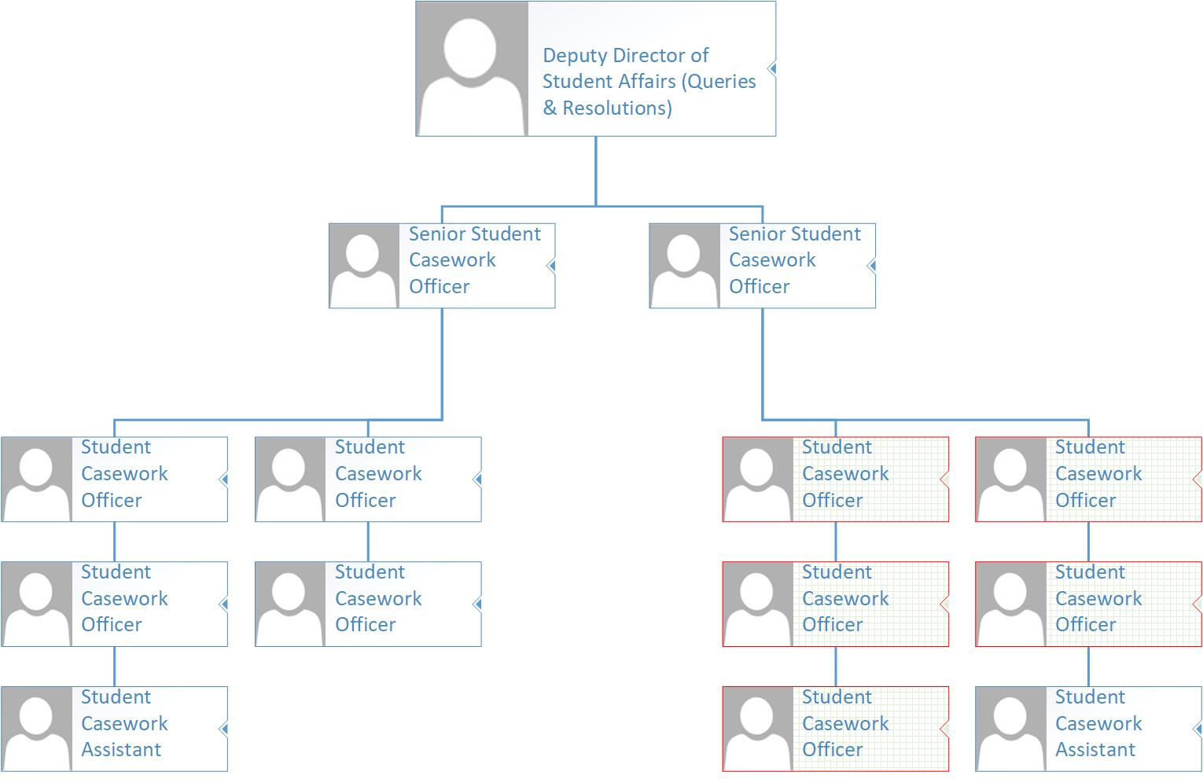
Student
Affairs
|

Slide 5
Stop 1 – Context – Structure
5 Student Casework Officers working 90% of time on EC claims
Equivalent to 4.29 FTE
Salary of c. £24,000
SCOs receive and log claims; identify and evaluate evidence; and decide claims
Team sits within wider Student Affairs department
Student
Affairs
|

Slide 6
Stop 1 – Context – Process
Claims received in hard copy or electronically via email / online enquiry service (no electronic form)
Claims assigned to SCOs according to cab-rank rule
Claims logged on Access database and decisions mail-merged in Word
Decisions sent via email to student and weekly to School
Initial challenges handled informally; formal appeal process then available
Student
Affairs
|

Slide 7
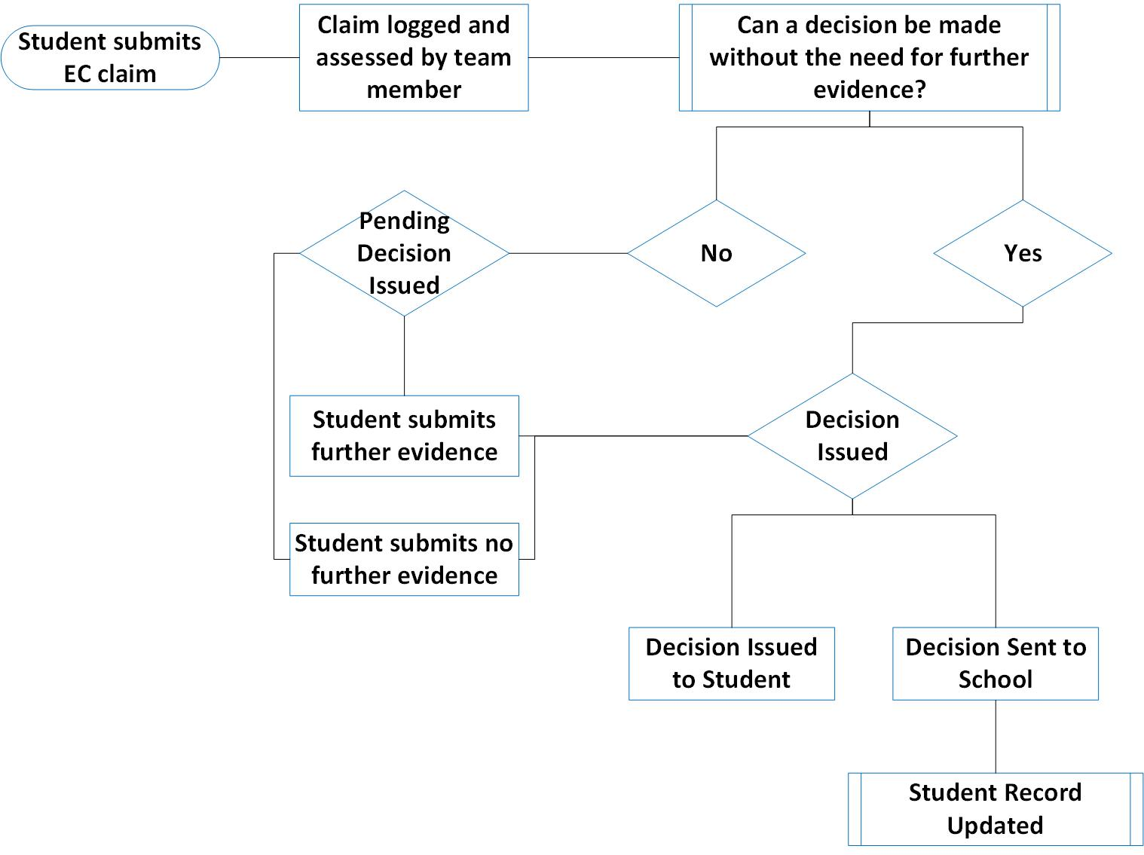
Student
Affairs
|

Slide 8
Stop 1 – Context – Numbers
 | No. students claiming | Claims received | Claim outcome
 |  |  | Successful | Unsuccessful | Withdrawn | Ineligible
2017/18 | 3213 | 7101 | 4446 | 2367 | 109 | 52
2016/17 | 2980 | 6896 | 4080 | 2656 | 119 | 30
2015/16 | 2562 | 6036 | 3543 | 2365 | 86 | 42
2014/15 | 1991 | 4492 | 2951 | 1441 | 100
2013/14 | 1852 | 3898 | 2319 | 1487 | 92
Student
Affairs
|

Slide 9
Stop 1 – Context – Numbers
Student
Affairs
|

Slide 10
Stop 2 – Centralised Consideration
The Advantages
Fairness
Consistency
Procedural awareness
Interaction with other casework
Interaction with other departments
Trend spotting and reporting
Case hardened
Student
Affairs
|

Slide 11
Stop 3 – Centralised Consideration
The Disadvantages
Resource
Student context
Procedural focus
Case hardened
Dissemination of decisions
Local trend spotting and reporting
Student
Affairs
|

Slide 12
Terminus – Conclusions
Centralised team requires dedicated resource
There are issues associated with a centralised team being distant from the local student context and broader student experience
However
Centralised decision-making ensures for consistent and fair application of University policy and procedure
Student
Affairs
|

Slide 13
Contact Details
Richard Booth
Deputy Director of Student Affairs (Queries & Resolutions)
Richard.booth@bcu.ac.uk
0121 331 7651
Student
Affairs
|

